Slide 1
Food Delivery Service for Professionals Story Board
By: Peter Tran

Slide 2
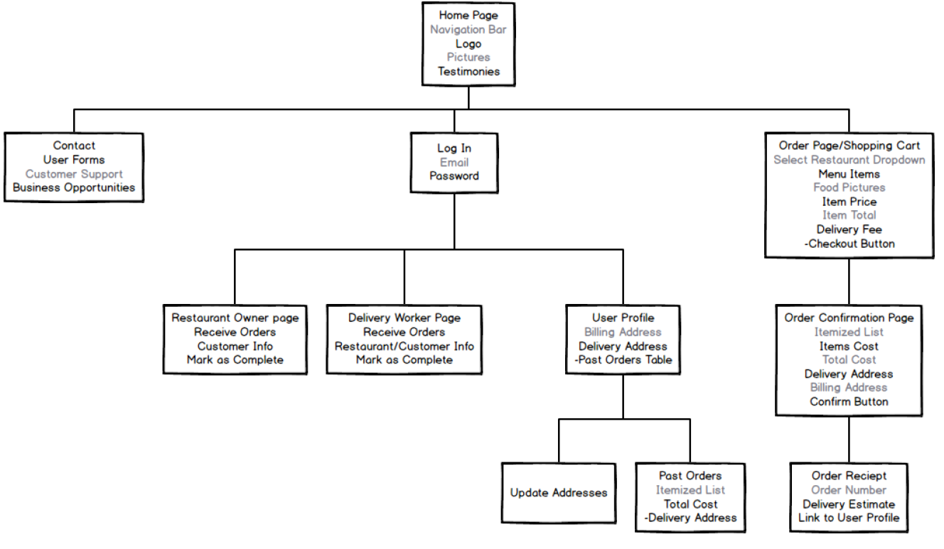
Website Layout

Slide 3
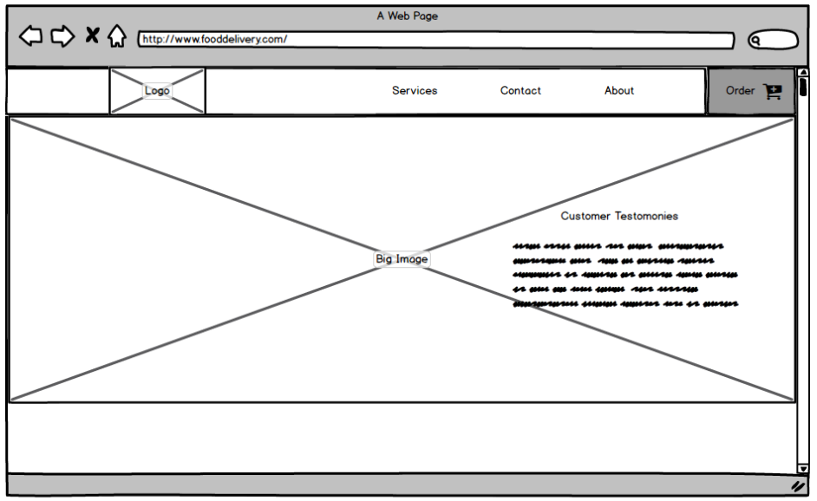
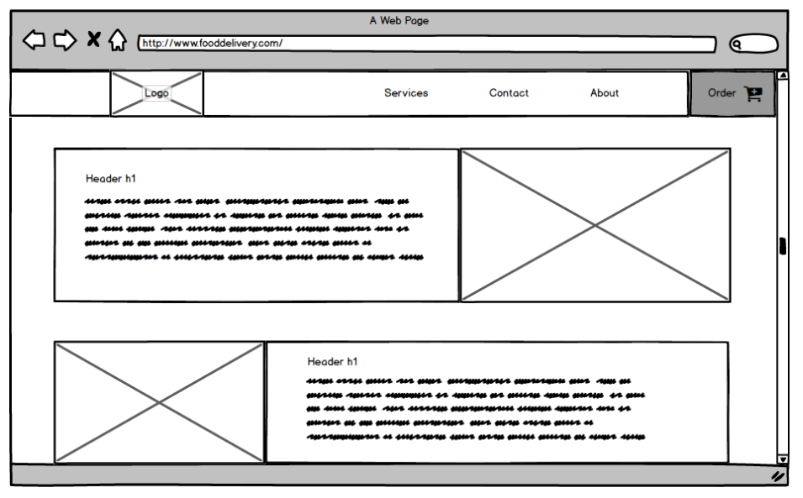
Customer sees the homepage with sample images, testimonies, cards with information and top navigation for next step. They can click Order button for next page

Slide 4
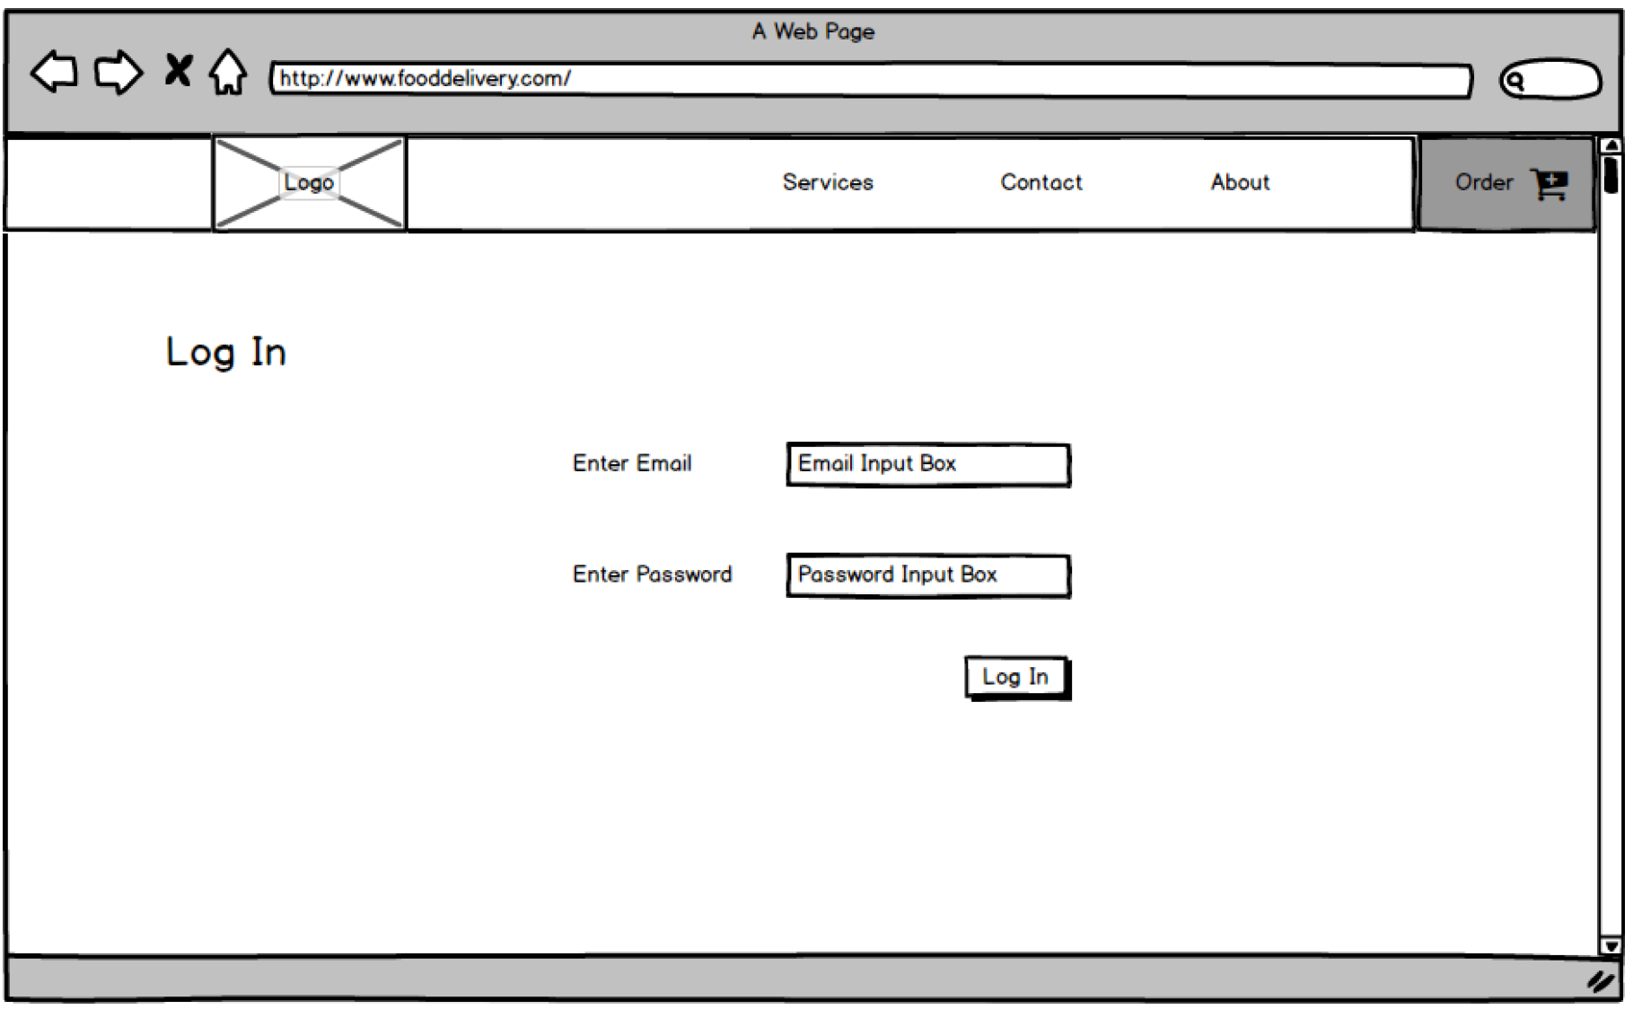
Customer will get a login screen to log into their profile

Slide 5
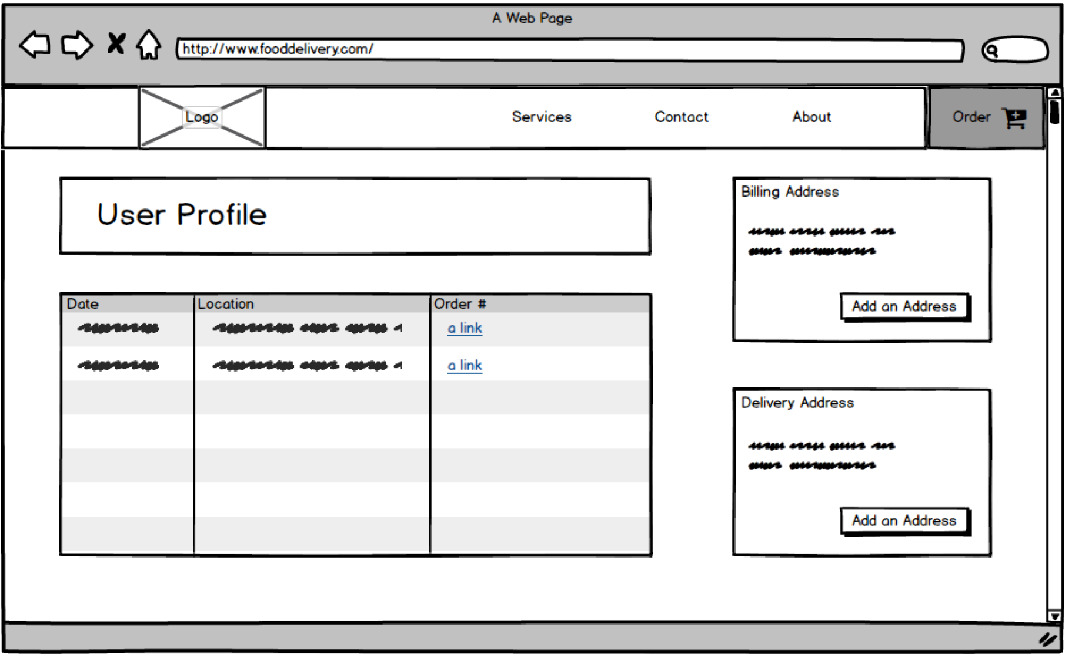
Customer will see their user profile page with their past orders and have information that they can update. They can click on a past order to see more details or click the order button

Slide 6
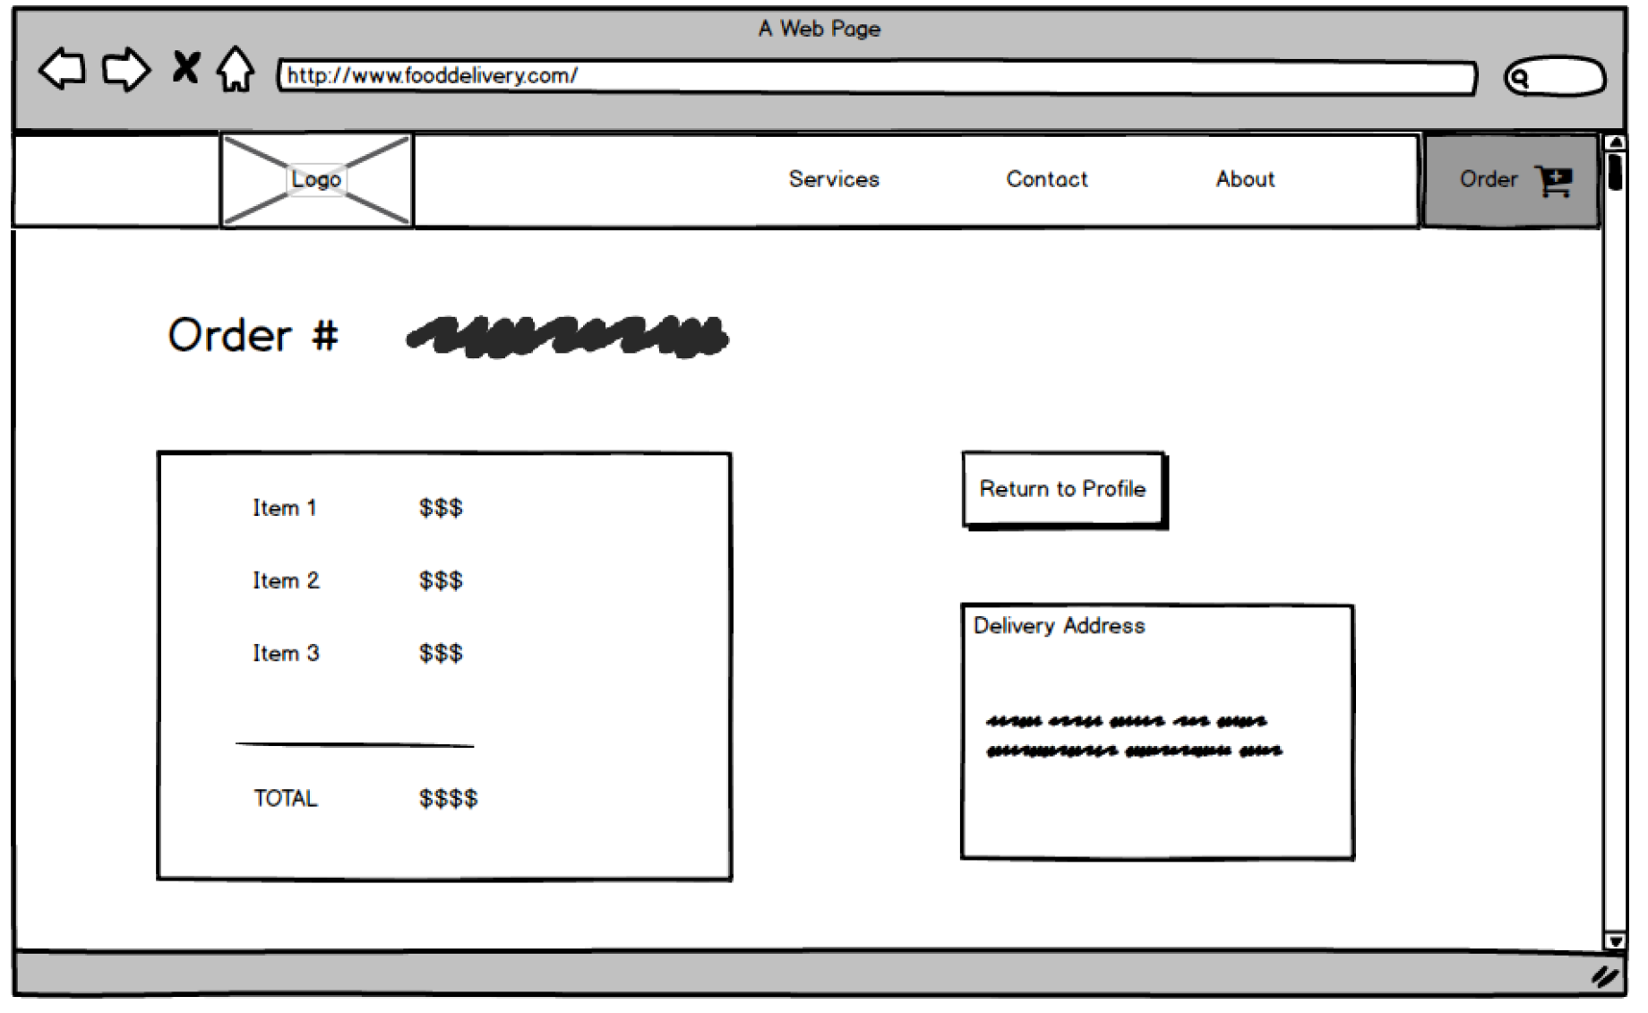
Customer can see the itemized list detail of a specific order number. They can use the top navigation or go back to their profile

Slide 7
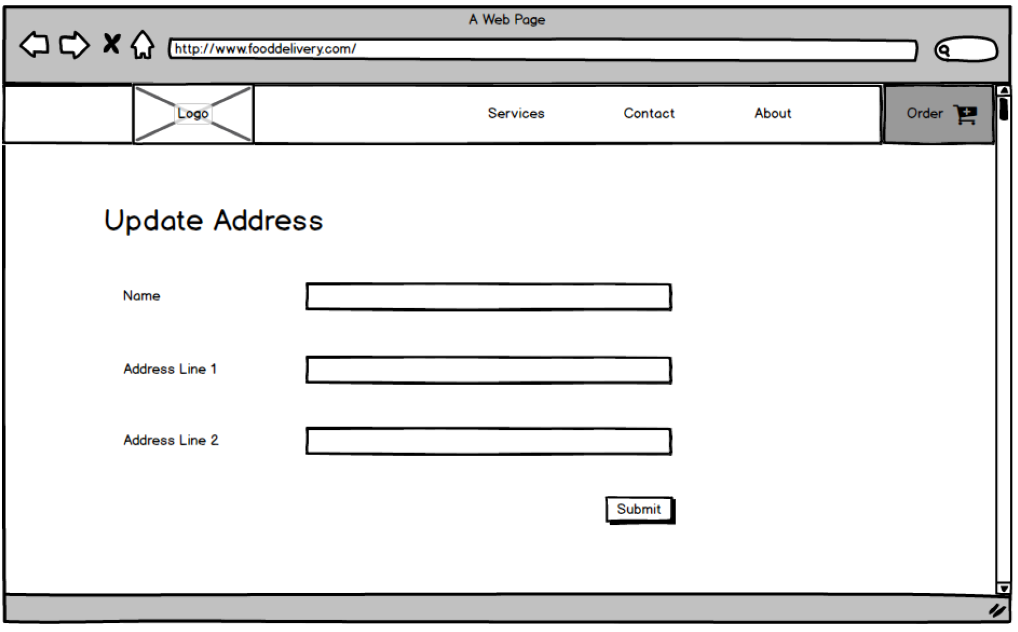
Customer can update their address using this web form. Submitting will bring them back to their user profile

Slide 8
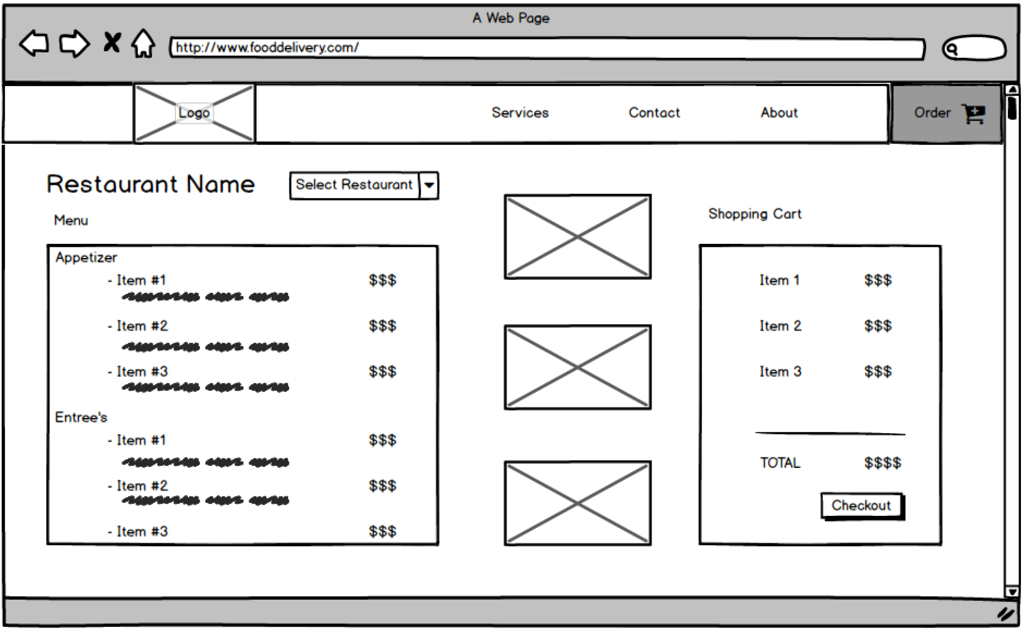
This is the Ordering page to view the restaurant menu or select different restaurants in their area. As they click on menu items, it will be added to their cart on the right. Their order will be totaled up and they are able to checkout.

Slide 9
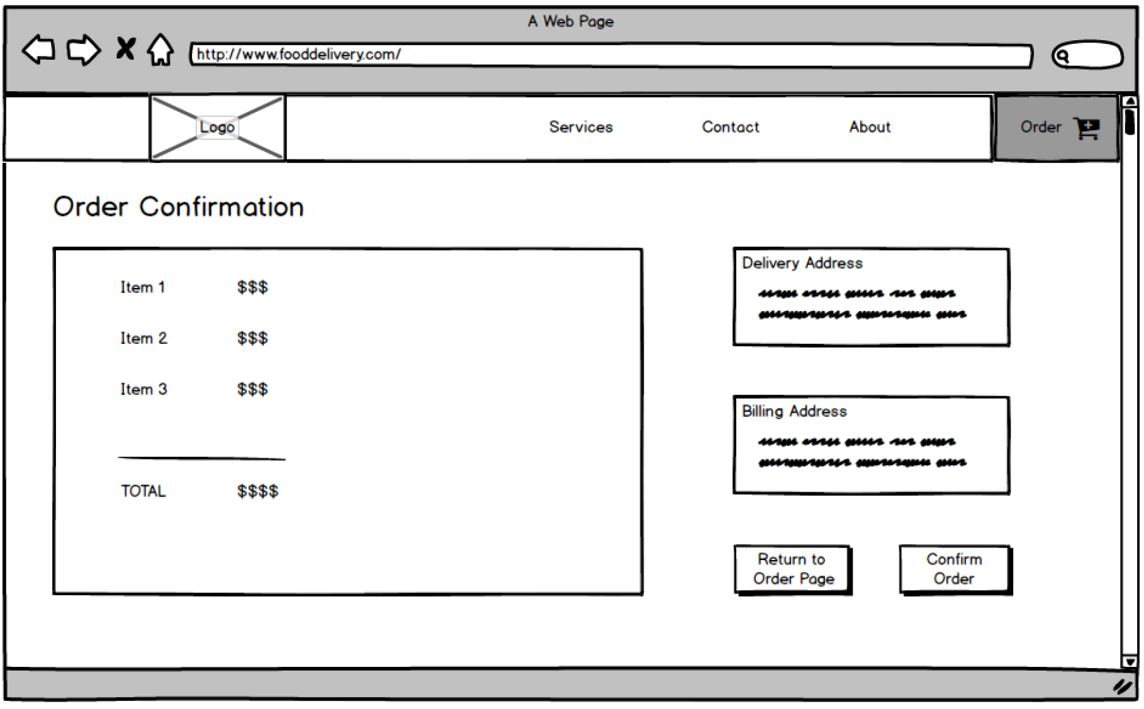
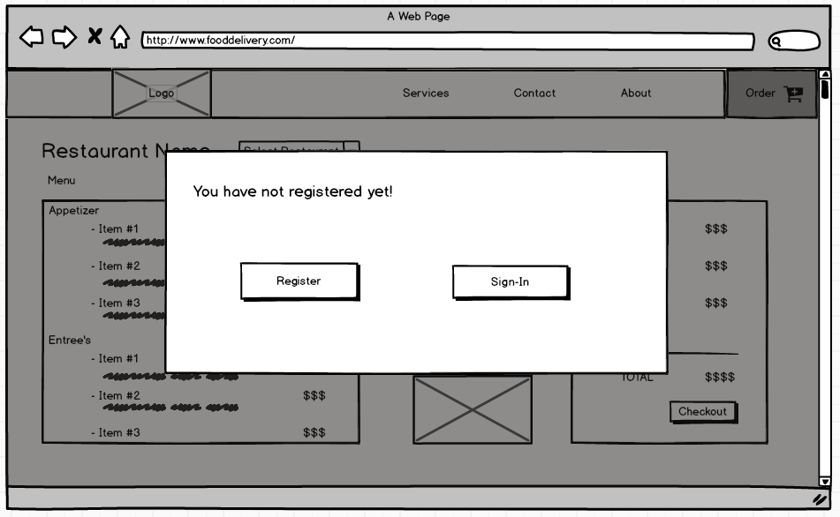
Customers will confirm their order and pay for their food. It will itemize out their choices and total it all up. It will also show any taxes and delivery fees here. They can either confirm the order or go back to the ordering page to edit their cart. If they have not signed in, a modal will pop up to ask user to register or login.

Slide 10
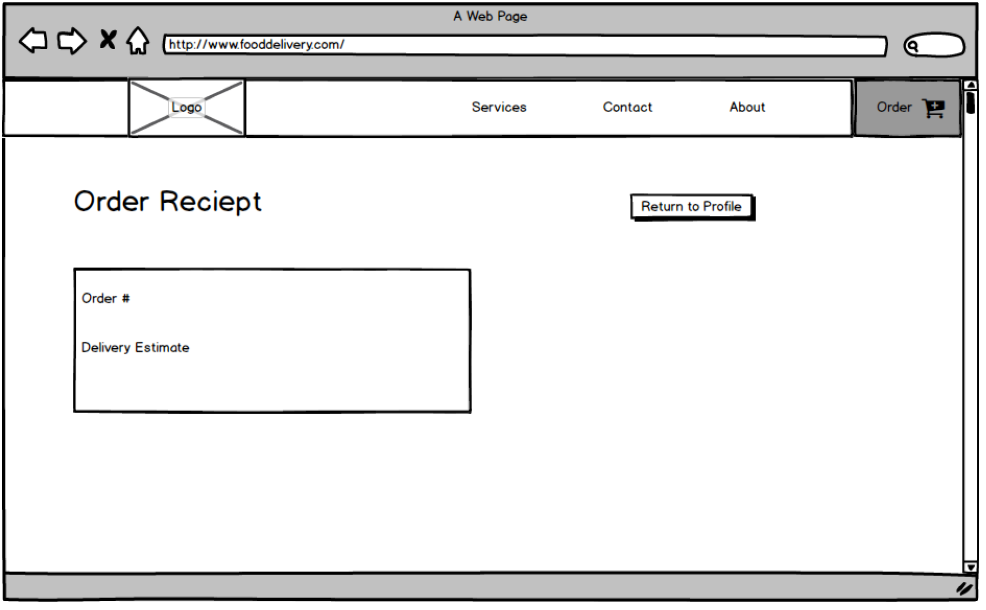
Once the customer pays for their food, they will be given a receipt with their order number and be given delivery time estimates.

Slide 11
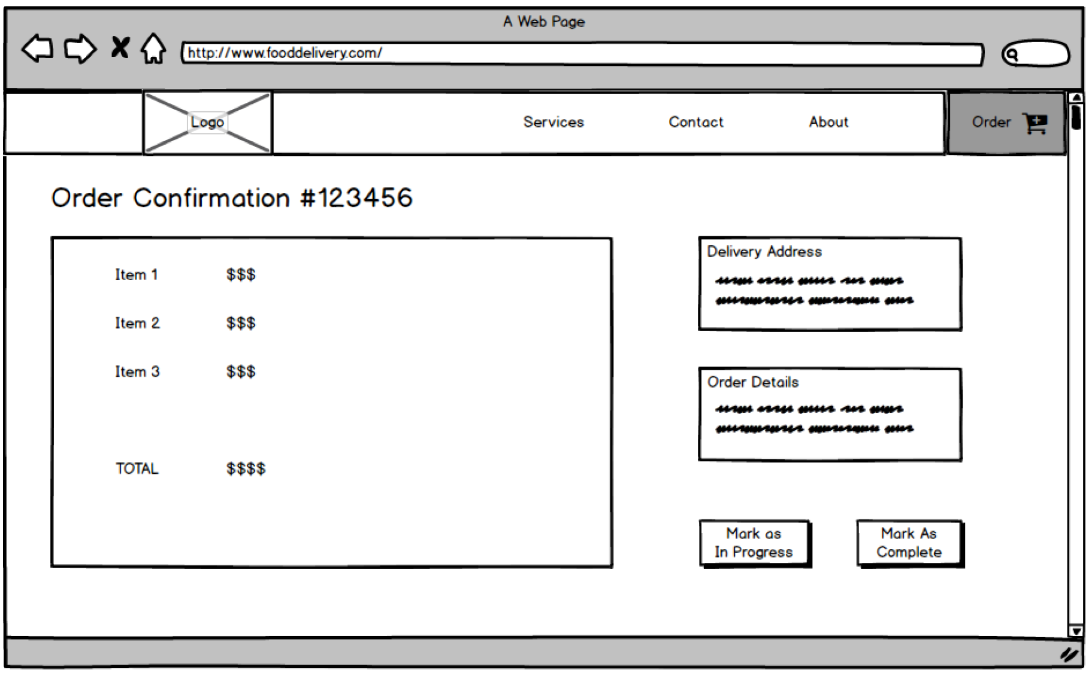
Restaurant has their own interface to show when orders come in, and what they need to prepare for the order. They have options to mark the item in progress or complete so that the customer can get real time updates on the status of their order. Clicking the Mark as Complete button will signal the delivery person to go pick up the food and receive payment for the food.

Slide 12
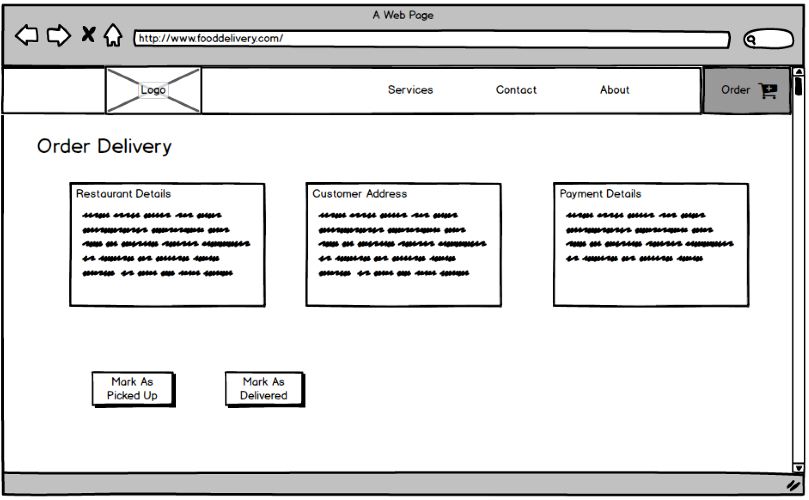
The Delivery staff will have their own interface to show what orders they need to pick up, and where they need to deliver the order. They have options to mark as picked up so that the customer can get real time updates on the status of their order. Clicking the Mark as Delivered button will give them payment for their delivery.

Slide 13
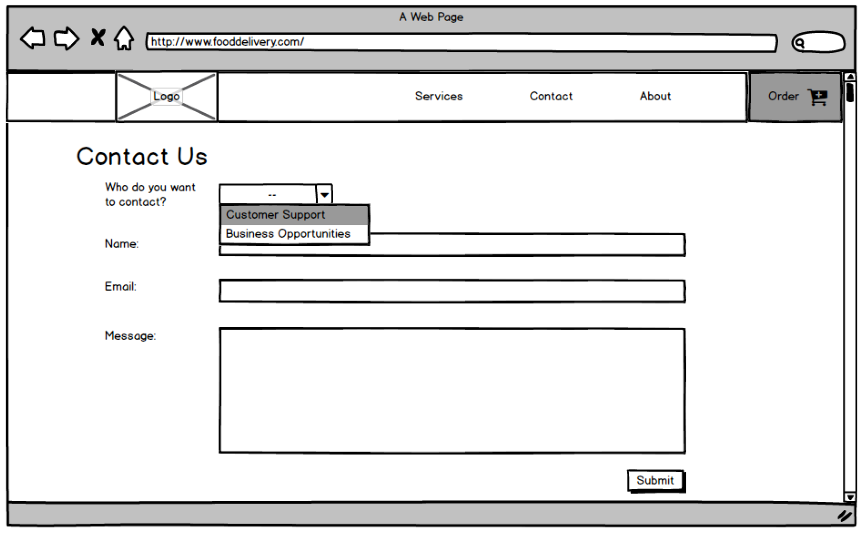
If a restaurant owner wants to add their restaurant for the delivery services, they can contact a web admin to get everything added using the web form below.

